Slide 1
"EBOLA VIRUS DISEASE, THE DEADLY MENACE“ A LECTURE PRESENTED BY DR. ODOH, MAXIMILLIAN IKENNA (MB; BS, Nig) UNIVERSITY HEALTH CENTRE (FUOYE) 3RD SEPTEMBER, 2014

Slide 2
OUTLINE
Introduction
Brief history
Epidemiology
Recent outbreak
Mode of transmission
Risk factors
Clinical features

Slide 3
OUTLINE CONTD.
Diagnosis
Laboratory investigations
Prevention
Treatment
Prognosis
Misconceptions
Differential diagnosis
Conclusion

Slide 4
INTRODUCTION
Ebola Virus disease (EBV) or African haemorrhagic fever is a highly infectious and deadly disease affecting humans and animals such as Monkeys, Gorillas, Chimpanzees, Bats, Birds, Reptiles, Amphibians, Arthropods. It is caused by Ebola virus and it occurs in sporadic outbreaks.

Slide 5
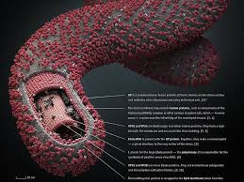
INTRODUCTION CONTD.
Ebola virus is an RNA virus which is from the Filoviruses family. it is morphologically identical but immunogically distinct from Marburg virus.

Slide 6
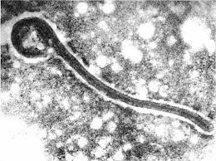
INTRODUCTION CONTD.
Whereas Marburg virus can probably be transmitted by Aedes aegypti mosquitoes; Ebola virus infection requires close contact with infected patient/specimen

Slide 7
INTRODUCTION CONTD.
Ebola virus has 5 species :
Bundibugyo EV (BDBV)
Zaire EV (EBOV)
Sudan EV (SUDV)
Reston EV (RESTV)
Tai Forest EV (TAFV)
The first 3 cause major outbreaks in man
The current outbreak is caused by Zaire species

Slide 8
BRIEF HISTORY
Ebola Virus Disease (EBVD) was first described in Germany and Yugoslavia in 1967. At the time, infection occurred following the handling of tissues of imported Velvet monkeys by laboratory workers in Marburg, West Germany. Hence, the name MARBURG DISEASE
In 1975, infection of an Australian and his contacts occurred in Zimbabwe and this was found to be due to Marburg disease.
A large epidemic of a similar illness and a similar virus occurred in 1976 in Southern Sudan and Democratic Republic of Congo on Ebola River and was named EBOLA VIRUS
Epidemics had also occurred in Kitwit, Democratic Republic of Congo lately in 1995 and in Gabon in 1996.

Slide 9
PATRICK SAWYER

Slide 10
EPIDEMIOLOGY
Ebola Virus Disease typically occurs in outbreaks in tropical regions of Sub-Saharan Africa.
Outbreaks of Ebola Virus Disease have been mainly restricted to Africa; with confirmed cases reported in countries like Liberia, Sierra Leone, Guinea, Ghana, Democratic Republic of Congo, Gabon, Sudan, Ivory Coast, Uganda and Nigeria.
Ebola Virus Disease is usually spread within a health care setting; with sporadic isolated cases occurring unnoticed.

Slide 11
EPIDEMIOLOGY contd.
Between 1976 when it was first identified through 2013; not fewer than 1 000 people per year have been infected with largest Ebola Virus Disease outbreak being the ongoing 2014 West Africa Ebola outbreak
Affected countries are, Guinea, Sierra Leone, Liberia and in August 2014, Nigeria
As of July 2014, over 1320 cases have been identified.

Slide 12
NURSES ATTENDING TO EVD PATIENT DURING 1976 OUTBREAK IN D.R. CONGO

Slide 13
RECENT OUTBREAK.
The number of suspected/confirmed cases of EVP in the recent 2014 West African Ebola outbreak have been on the increase
Report from World Health Organization (WHO) released on August 4, 2014 in conjunction with Ministry of Health in the affected countries is presented below

Slide 14
COUNTRY | CONFIRMED/SUSPECTED | SUSPECTED CASES OF DEATH
GUINEA | 648 | 430
LIBERIA | 1 378 | 694
SIERRIA LEONE | 1 026 | 422
NIGERIA | 17 | 7
TOTAL | 3 069 | 1 553
An extract from Ebola Virus Disease, West Africa fact sheet from WHO ; August 29,2014.
Notes:
ON 27TH 0F AUGUST 2014;THE HONOURABLE MINISTER OF HEALTH PROF.ONYEBUCHI C. CHUKWU ANNOUUCED TO NIGERIANS AFTER FEDERAL EXECUTIVE COUNCIL THAT THERE IS ONLY ON EBOLA CASE UNDER SURVEILLANCE IN LAGOS BUT PEOPLE SHOULD NOT REJOICE YET.THE FOLLOWING DAY;A DOCTOR THAT MANAGED PATRICK SAWYER’S CONTACT,THE WEST AFRICAN DIPLOMAT DIED IN PORT-HARCOURT;RIVERS STATE.
AND 70 PEOPLE WERE QUARANTINED.

Slide 15
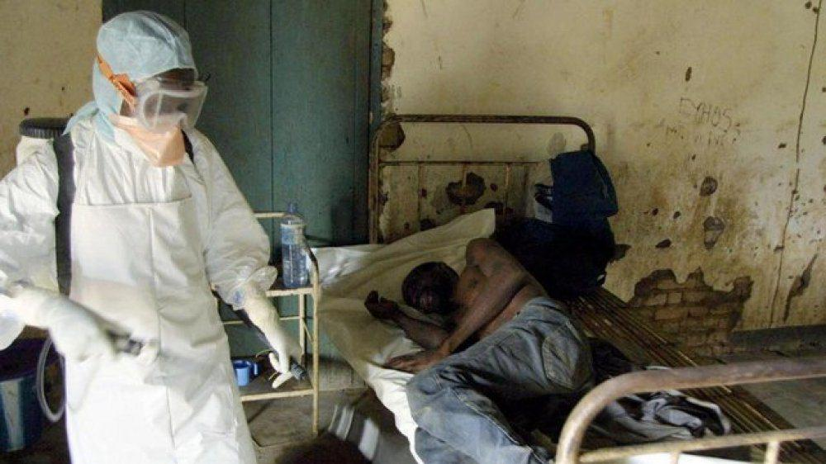
In Guinea, active surveillance continues in Conakry, Gueckedou, Boffa, Pita, Siguiri, and Kourourssa Districts.

Slide 16
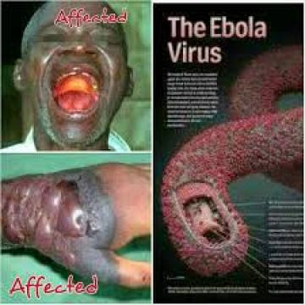
EBVD has been reported from districts like Kailahun, Kenema, Kambia, Port Loko, BO and Western area (which includes Free town) in Sierra Leone. more recently, there are also confirmed cases from Tonkolili, Bambali, Moyamba, Bonthe and Punjehn districts.

Slide 17
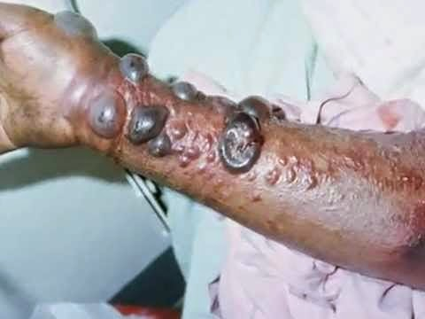
In Liberia, suspected and confirmed cases were reported from Lofa, Montserado, Margidi, Bomi, Bong, Nimba, Rivercess, Grand Cape Mount and Grand Bassa countries.

Slide 18
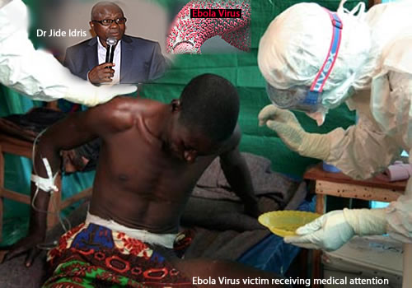
In Nigeria, EBVD is confined to Lagos state with recent established escapee to Enugu state and death in Port-Harcourt ; Rivers state.

Slide 19
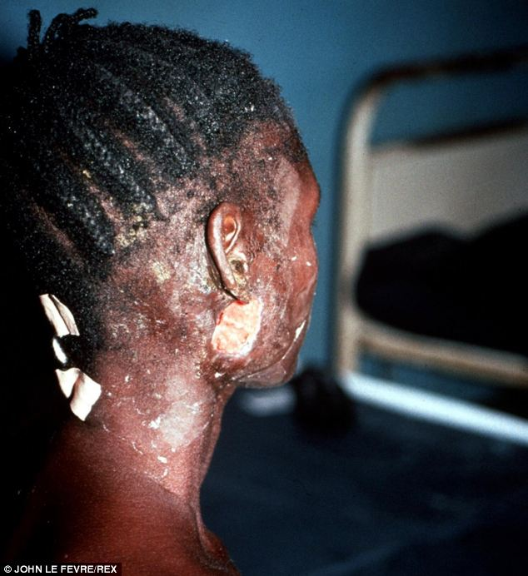

Slide 20
MODE OF TRANSMISSION
The manner in which the Ebola Virus appears in human at the onset of outbreaks has not been established but the disease (EBVD) could be spread through the following means;
Direct contact with an infected animal or humans.
Direct contact with the blood and or secretions of an infected person especially within families.
Contact with contaminated medical equipments such as needles, drip stand, etc.
Re use of unsterilized instruments in hospitals.

Slide 21
MODE OF TRANSMISSION CONTD.
Handling of the carcass of infected animals.
Inhalation of contaminated air in hospital environment.

Slide 22
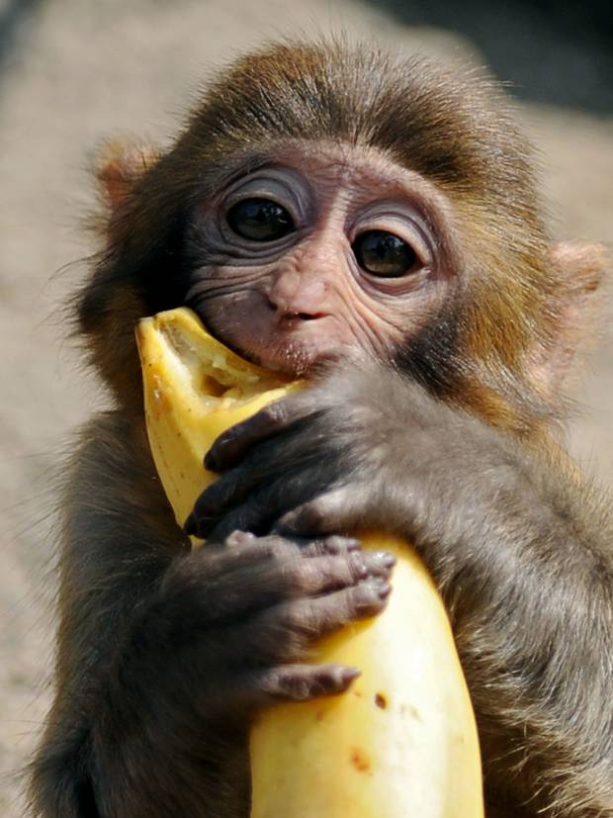
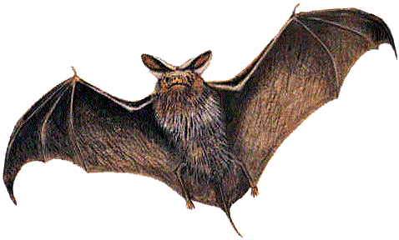
MODE OF TRANSMISSION CONTD.
Use of infected non human primate/bats as food source (BUSH MEAT).
Non implementation of universal precautions e.g. Hand Washing.

Slide 23
RISK FACTORS FOR EVD
Health workers in hospital settings with poor basic hygiene and sanitation practices.
Family members of infected patients.
People that visit hospitals with poor hygiene and sanitation practices.

Slide 24
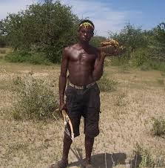
RISK FACTORS FOR EVD CONTD.
People at risk of Ebola Virus infection include;
Those exposed to and handling of wild animals.
Those with poor personal hygiene.
Those depending on wild animals such as bats as a food source.
Health workers caring for EVD patients.

Slide 25
CLINICAL FEATURES (SIGNS & SYMPTOMS)
The incubation period for EVD ranges from 2 to 21 days with average of 5-10days.
The signs and symptoms include;
EARLY SYMPTOMS;
Fever
Headache
Diarrhoea
Orchitis
Vomiting
Chest pain
Hepatomegaly
Stomach pain

Slide 26
CLINICAL FEATURES (SIGNS & SYMPTOMS) CONTD.
Cold
Pancreatitis
Cough
Joint and muscles pain
Sore throat
LATE SYMPTOMS;
Weakness
Depression
Confusion
Red eyes
Internal and External bleeding
DIC
Maculopapullar rash in about 50% cases. Patient may be vomiting blood, coughing out blood or passing blood in stool.

Slide 27
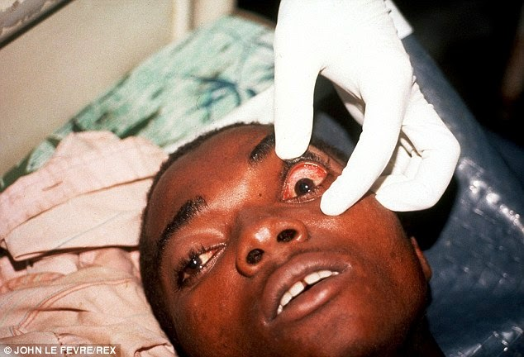
REDNESS OF THE EYES IN AN EBV PATIENT.

Slide 28
Bleeding from the mouth in an EBV Patient.

Slide 29
DIAGNOSIS
High index of suspicion.
History of travel to places of recent outbreaks.
History of occupation, especially exposure to wild life.
EVD diagnosis is essentially that of exclusion because signs and symptoms have some resemblance to that of other diseases like malaria, typhoid fever, etc.

Slide 30
LABORATORY INVESTIGATIONS
To help establish or confirm the diagnosis of EVD
Confirmation is by;
Isolating the virus by cell culture.
Detection of the viral RNA by Polymerase Chain Reaction (PCR).
Detection of the viral proteins by ELISA.
Detection of antibodies against the virus.

Slide 31
Other non specific investigations include;
Full blood count
Liver function test
Urinalysis
MP and WIDAL
Abdomino-pelvic ultrasound

Slide 32
PREVENTION
1. Health workers and visitors caring for Ebola patients should;
a. Wear personal protective equipment such as disposable face mask, gloves and goggles.
b. Wear protective gowns/overall always.
c. Use disposable needles.
d. Avoid reuse of needles or use of inadequately sterilized instruments.
e. Avoid embalming of a deceased Ebola patient.

Slide 33
PREVENTION CONTD.
EVD can be prevented by;
2. Avoiding contact with the blood or secretion of Ebola infected animals and humans and dead bodies by;
a. Maintaining good hygiene and sanitation practices in hospitals.
b. Isolation of Ebola infected patients.
c. Dispose of dead bodies of Ebola patients properly in a safe manner.
d. Avoiding local traditional burial rites/rituals such as embalming for Ebola patients.

Slide 34
TREATMENT
NONE FOR NOW!!!
Researches are currently on going.

Slide 35
TREATMENT CONTD.
ZMapp; an experimental drug was first tested in
humans on August 4, 2014.
Nitro-Silver; still controversial.
7 out of 8 people who received blood transfusions
from individuals who previously survived the infection
survived themselves, but this is still controversial.
No vaccine for humans yet.

Slide 36
AMERICAN DOCTOR THAT CONTACTED EVD IN LIBERIA IN WHOM ZMapp WERE USED WITH GOOD OUTCOME

Slide 37
TREATMENT CONTD.
Management of patients with EVD is essentially supportive involving antibiotics, fluid (ORS and Infusions) and electrolyte replacement and blood transfusion.
Administration of hyper immunoglobulin at an early stage may help reduce incidence of morbidity.

Slide 38
PHYSICIAN AND EVD PATIENT IN AN ISOLATION CAMP.

Slide 39
PROGNOSIS
EVD has a high mortality rates often between 50-90%.
Prolonged cases are often complicated by the occurrence of long term problems like inflammation for the testicles, joint pains, muscle pains, skin peeling or hair loss.
It may persist in the semen of some survivors for up to seven weeks; which could give rise to infections and disease via sexual intercourse.
If an infected person survives, recovery is usually quick and complete.

Slide 40
MISCONCEPTIONS
SALT AND WARM WATER BATH
KOLA NUT AND BITTER KOLA

Slide 41
DIFFERENTIAL DIANOSIS
Other viral haemorrhagic fevers e.g.
Lassa
Falciparum malaria
Typhoid fever
Infectious diseases like;
i. Leptospirosis
ii. Trypanosomiasis
iii. fulminant Hepatitis
iv. Measles
v. Haemorrhagic small pox
vi. Scrub thyphus

Slide 42
DIFFERENTIAL DIANOSIS CONTD.
Non infectious disease like;
Snake envenomation.
Clotting factor deficiencies/platelet disorders.
Haemolytic ureamic syndrome.
Acute promyelocytic leukaemia.
Hereditary haemorrhagic telangiectasia.
Warfarin poisoning.

Slide 43
FOOD FOR THOUGHT
I can actually help reduce the spread of Ebola virus infection/ disease by …..

Slide 44
CONCLUSION
EVD is no longer a story/myth.
Contact/handling of wild life and infected persons (or carcass) remains the potential source of infection.
Early presentation in the health center/ hospital helps to reduce mortality rate.
Best mode of prevention remains;
Proper sensitization/Health education
Proper sanitation and good personal hygiene especially hand washing with soap and running water.

Slide 45
REFERENCES
"Ebola virus disease fact sheet No 103". World Health Organization; March 2014.
"Ebola Viral Disease Outbreak - West Africa, 2014". CDC June 27, 2014.
Gatherer, D (August 2014) "The 2014 Ebola virus disease outbreak in West Africa: "The Journal of general virology 95 (pt. 8).
Grolla, A; Lucht, A; Dick, D; Strong, J.E; Feldmann, H; (2005) "Laboratory diagnosis of Ebola and Marburg haemorrhagic fever" Bull Soc. Pathol. Exot 98(3).
Gear, J. H; (1989) "Clinical aspects of African viral haemorrhagic fevers" Review of infectious diseases II Suppl 4.S777-S782.
Bogomolov, B.P (1998) "Differential diagnosis of infectious diagnosis with haemorrhagic syndrome". Terapevticheskii. arkhiv 70(4): 63-68.
Saphire, E.O (November, 2013) "An update on the use of antibodies against the filoviruses" Immunotherapy 5 (11): 1221 – 33.
"Mystery Ebola virus serum manufactured by San Diego firm" Los Angeles Times August 4, 2014.
Falase, A.O; Akinkugbe, O.O; (2007) "A compendium of clinical medicine" Spectrum Books Limited, Ibadan, Nigeria pgs 668-9.
"Ebola Virus disease fact sheet" produced by Federal Ministry of Health, Health promotion Division in collaboration with Nigeria Centre for Disease Control, Abuja (August, 2014).

