Slide 1
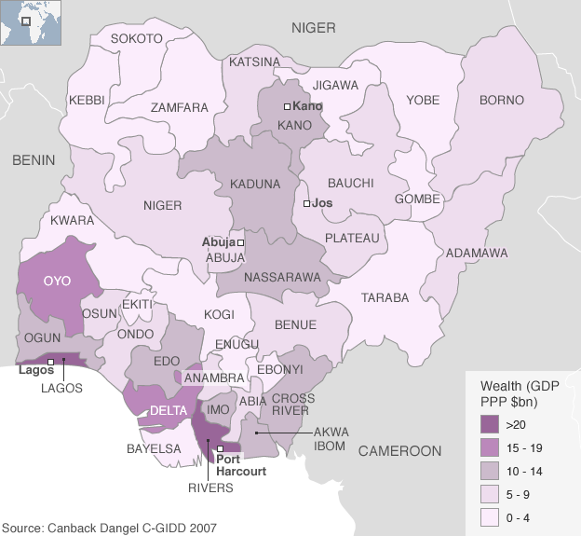
RURAL POVERTY ALLEVIATION IN NIGERIA: WITHAL?
THE NATION OF NIGERIA

Slide 2
Being a public lecture presented in Federal University, Oye Ekiti
by
FASORANTI OLAYIWOLA O. (PhD)
BSc, MSc, (Uniben), PhD (OAU, Ile-Ife)
Reader, Sociology Department
FEDERAL UNIVERSITY
OYE EKITI
NIGERIA

Slide 3
Introduction
Poverty is a denial of choices and opportunities, a violation of human dignity. It means lack of basic capacity to participate effectively in society. It means not having enough to feed and clothe a family, not having a school or clinic to go to; not having the land on which to grow one’s food or a job to earn one’s living, not having access to credit. It means insecurity, powerlessness and exclusion of individuals, households and communities. It means susceptibility to violence, and it often implies living on marginal or fragile environments, without access to clean water or
sanitation.(World Bank Statement, 2005)

Slide 4
Rural Poverty
Rural poverty simply refers to poverty found in rural areas. Rural poverty is a global phenomena, but like poverty in general, there are higher rates of rural poverty in developing countries than in developed countries. Eradicating rural poverty through effective policies and economic growth remains a challenge for the international community Poverty remains a predominantly rural problem, with a majority of the world’s poor located in rural areas. It is estimated that 76 percent of the developing world’s poor live in rural areas, well above the overall population share living in rural areas, which is only 58 percent. Disparities between rural and urban areas is on the rise, particularly in many developing and transitional countries. Globally, rural people and rural places tend to be disadvantaged relative to their urban counterparts and poverty rates increase as rural areas become more remote. Individuals living in rural areas tend to have less access to social services, exacerbating the effects of rural poverty.
Rural poverty is a global problem (IMF 2001)

Slide 5
An example of Rural Poverty in Jakarta in Indonesia

Slide 6
Payatas Dumpsite in Manila, Philipines Here, the poor resort to scavenge for survival.

Slide 7
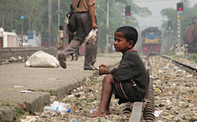
A street child begging for livelihood in a railway station in Srimangal, Bangladesh

Slide 8
Local citizens from the Jana bi Village wait their turn to gather goods from the Sons of Iraq

Slide 9
A Somali village boy receiving treatment for malnourishment

Slide 10
A Nigerian village beggar-boy

Slide 11
A typical village market in Nigeria depicting poverty and backwardness

Slide 12
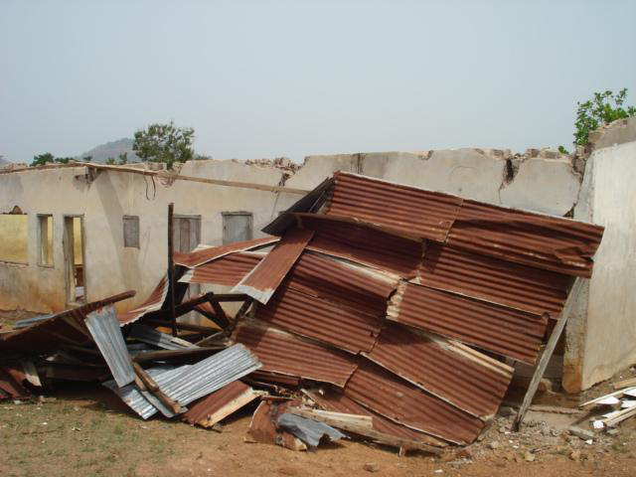
A Rural Primary School in Ondo State With blown off roof and the Staff Room Under the Tree

Slide 13
Poverty can be divided into :
Absolute poverty or destitution which refers to the deprivation of basic human needs, which commonly includes food, water, sanitation, clothing, shelter, health care and education. The World Bank anchored absolute poverty line as $1 per day. This was revised in 1993, and through 2005, absolute poverty was $1.08 a day for all countries. In 2005, after extensive studies of cost of living across the world, The World Bank raised the measure for global poverty line to reflect the observed higher cost of living. Now, the World Bank defines extreme poverty as living on less than US$1.25 per day.
*Moderate poverty as less than $2 or $5 a day (but note that a person or family with access to subsistence resources, e.g. subsistence farmers, may have a low cash income without a correspondingly low standard of living – they are not living "on" their cash income but using it as a top up).

Slide 14
*Relative poverty, defined contextually as economic inequality in the location or society in which people live.
Poverty differences cut across gender, ethnicity, age, location (rural versus urban), and income source.
In households, children and women often suffer more than men.
In the community, minority ethnic or religious groups suffer more than majority groups, and the rural poor more than the urban poor; among the rural poor, landless wage workers suffer more than small landowners or tenants.
In Sub-Saharan Africa, extreme poverty went up from 41 percent in 1981 to 46 percent in 2001, which combined with growing population increased the number of people living in extreme poverty from 231 million to 318 million.

Slide 15
World Bank data shows that the percentage of the population living in households with consumption or income per person below the poverty line has decreased in each region of the world since 1990, however, the figures of Sub-Saharan Africa remain the highest.
Region | $1 per day |  |  |  | $1.25 per day
 | 1990 | 2002 | 2004 |  | 1981 | 2008
East Asia and Pacific | 15.40% | 12.33% | 9.07% |  | 77.2% | 14.3%
Europe and Central Asia | 3.60% | 1.28% | 0.95% |  | 1.9% | 0.5%
Latin America and the Caribbean | 9.62% | 9.08% | 8.64% |  | 11.9% | 6.5%
Middle East and North Africa | 2.08% | 1.69% | 1.47% |  | 9.6% | 2.7%
South Asia | 35.04% | 33.44% | 30.84% |  | 61.1% | 36%
Sub-Saharan Africa | 46.07% | 42.63% | 41.09% |  | 51.5% | 47.5%
World |  |  |  |  | 52.2% | 22.4%

Slide 16
The Nigerian Rural Poor
Nigeria's population in poverty
1980: 17.1 million
1985: 34.7 million
1992: 39.2 million
1996: 67.1 million
2004: 68.7 million
2010: 112.47 million
Source: Nigeria's National Bureau of Statistics
GNI per capita, Atlas method (current US$) -1,180.0
Population, total -158,423,182.0
Rural population -79,528,437.4
Number of rural poor (million, approximate) -50,739
Source: Federal Bureau of Statistics, 2011
As shown above, in Nigeria, about 80 million Nigerians live in the rural areas. Out of this, about fifty one million are caught up in the throes of poverty.

Slide 17
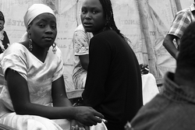
Poverty is especially severe in rural areas, where social services and infrastructure are limited or non-existent. The great majority of those who live in rural areas are poor and depend on agriculture for food and income. About 90 per cent of the country’s food is produced by small-scale farmers cultivating tiny plots of land who depend on rainfall rather than irrigation systems.
Women play a major role in the production, processing and marketing of food crops. The poorest groups eke out a subsistence living but often go short of food, particularly during the pre-harvest period.

Slide 18
A high proportion of rural people suffer from malnutrition and other diseases related to poor nutrition.
Women and households headed by women are frequently the most chronically poor within rural communities. Women have lower social status than men and consequently less access to schooling and training, particularly in childcare and health practices. Yet women play significant roles in rural economic activities. (Fasoranti, 2009)
Other vulnerable groups among rural poor people are young couples with children, the disabled, and old people with no relatives to support them.

Slide 19
Distribution of the Rural Poor in Nigeria
Rural poverty tends to be evenly distributed across the country, rather than concentrated in specific geographic areas. However, in some zones the poverty situation threatens to worsen considerably, such as in the northern area bordering the Niger, which is arid, marginal to agriculture, environmentally damaged and densely populated. The fishing communities living in the mangrove swamps and along the Atlantic coast are among the poorest in Nigeria. It is estimated that Sokoto state's poverty rate the highest at 86.4%. In the north-west and north-east of the country poverty rates were recorded at 77.7% and 76.3% respectively, compared to the south-west at 59.1%.

Slide 20
Causes/Origin of Rural Poverty
Chambers (2008:107) opines that poverty is as a result of the fact that the rural poor are “incapably improvident, lazy, fatalistic, ignorant and stupid”. A cursory look at the peasantry in Nigeria proves the contrary. The average rural person in Nigeria is hand-working, struggling against the forces of nature and economic recession to provide subsistence often for the immediate and extended family. Improvidence (lack of savings for investment) is therefore often a result of the responsibilities that he has to shoulder; and fatalism (perceived inability to control the future)is a result of many hazardous experiences to which he has been exposed.

Slide 21
In Nigeria, it is apparent that rural poverty is product of urban-biased development policies which have put the rural areas in an unfavourable situation (Akinde, 2000). The reasons for rural poverty, Akinde (2000:2) contends, “has been traced to the exploitation of the rural population by the urban elites and middle-men and women and the neglect by the nation’s economic planners”.
Johnston (2007) argued that the rural poor are victims of exploitation by the local elites through three clusters which he described as:
“Nets”: The trapping and catching of resources and benefits meant for the rural areas by the local elites.” Most government, parastatal and private sector programmes and campaigns are either designed intentionally for the elites or so designed and implemented that they are likely to be intercepted by them”.
“Robbery”: The use of deception, blackmail and violence by the elite to rub the poor. This is made possible because “police, government officials and the larger land-owners and the traders have common understanding”.
“Bargaining and its absence”: This applies to the prices paid on products from the rural areas(131-138).

Slide 22
In a summary, the rural poor in Nigeria is that average rural dweller that has little or often nothing to feed on, lives under very poor, unhygienic conditions, cannot afford the basic needs of life including clothing, shoes and medical care; whose children are always victims of incessant fees-drive from elementary to secondary schools levels. The poverty is further reflected on the children who often go to school in tattered dresses often without shoes with only exercise books but essentially without necessary reading books. Being a victim of environmental circumstances, he is not fatalistic but hopeful, always working up to providence to burst the vicious circle, struggling to train the children who are hoped to be the possible potent outlet from the grips of poverty.

Slide 23
Strategies of Rural Poverty Alleviation: The Nigerian Experience
In the first decade after independence, Nigeria’s policy on poverty alleviation was not well defined or specific because the issue of poverty then, was not much of a problem. However, in 1970’s natural resources endowment were seen to be crucial hence the 1970-74 Development plan, stated that Nigeria should become, “a just and egalitarian Society” and a land of bright and full opportunities for all citizens. During this period Agriculture and rural development were stressed. The fourth National Development plan emphasized an increase in the real income of the average citizen and more even distribution of income among individuals and socio-economic groups among others as a way of dealing with poverty.

Slide 24
Certain programmes were initiated either wholly by the government or in collaboration with international agencies, which had a far-reaching effect on poverty alleviation. Among these programmes were:
River Basin Development Authorities (RBDA)
Agricultural Credit Guarantee Schemed (ACGS)
Rural Electrification Scheme (RES) and
Rural Banking Scheme (RBS).
Agricultural Development Programme (ADP).
Directorate of food road and rural infrastructure (DFFRI)
1976 the International Labour Office (ILO) conference launched Basic Needs
1994 FGN launched NDE which had four main programmes that not only enhance productivity and income earning potentials of the youth and other beneficiaries.
These programmes include the Vocational Skill Development programme(VSD) the Special Public Works programme (SPW), the Small Scale Enterprises programme (SSE) and the Agricultural Employment Programme

Slide 25
Others included Better Life For Rural Women
Family Support Programme
National Economic Empowerment and Development Scheme (NEEDS)
State Economic Empowerment and Development Scheme (SEED) with an agency for poverty alleviation (Agency for Poverty Alleviation – APA).
The United Nations Millennium Development Village Approach
Upon the commissioning of the Millennium Development
Goals, the U. N resolved to establish Millennium Development Villages in some African Countries including Nigeria

Slide 26
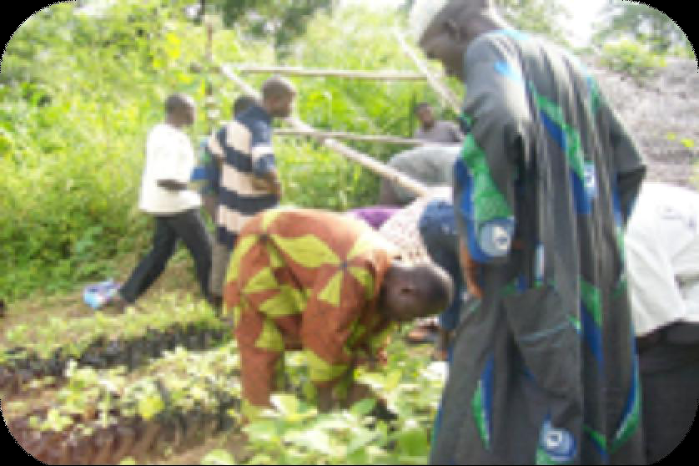
The Ikaram MV
Farmers planting

Slide 27
How Far?
These programmes were designed to cater for poverty related objectives like employment generation and to arrest rural urban drift by offering improved rural infrastructures. Some of these programmes indeed brought about improvement in the agricultural sector; however, they gradually experienced decline in their activities due to policy changes including cut -down budget allocation and lack of effective and honest management .
One can rightfully argue that the aims and objectives of many of these attempts are not noble. Indeed, with respect to these programmes, it has been said “If the policies and paradigms generating underdevelopment are similar or identical, the consequences of successive renovations of the essence of the paradigm are predictable” (Olorode, 2005).

Slide 28
A major flaw in all the programmes is that the peasantry was completely excluded in the processes of policy formulation and execution of these programmes. Indeed, they were just to receive whatever every successive government brings. In effect, the rural poor benefits little from these national and state policies and in many instances, they are only marginally influenced and in others, never at all.
One has always wondered “Whose interest is a rural development programme or poverty alleviation strategy genuinely intended to serve?”. The Imperialist’s represented by the World Bank? The pretending political class who would always call back on the rural people for their votes?; or the unsuspecting, helpless rural populace?. It is Paradoxical that in launching the programmes meant for the rural poor and poorest, he dares not show his poverty riddled face !

Slide 29
It is a well know fact in Nigeria by anyone who cares to find out that the rural poverty alleviation programmes and policies were received programmes (from the IMF and the World Bank) “whose purposes were sheer gimmicks and in social engineering and con-manship”.(Olorode, 2005) Regrettably, the consequences of all of these are always the same: the enhancement of the pockets of party loyalists or favoured individuals.
Finally, corruption at all levels and fraudulence of the elites who were ipso-facto expected to be the conveyor belt for rural poverty alleviation is a bane of rural development.

Slide 30
Indeed, Corruption in Nigeria and to a greater extent in Africa remains the most important obstacle, if not nuisance, to economic and social development and poverty eradication.

Slide 31
RECIPE FOR POVERTY ALLEVIATION IN RURAL AREAS IN NIGERIA.
Poverty is a social problem and its solution should be sought in the social realm (Fasoranti, 2003). The policy makers in Nigeria need to put the wishes of the rural people first, in designing a programme that will affect them. This would involve creating common ground between government perception of rural needs and the rural dwellers perception of their own needs. This will provide moral foundation for next stages and form concrete bedrock for government policy.
Furthermore, there should be a redefinition of rural development to involve “a strategy to enable a specific group of people, poor rural woman and man to gain for themselves and their children, more of what they want and need”

Slide 32
The issue of rural poverty cannot be faced in piecemeal and adhoc manner the way it is being handled by the Nigerian successive governments. Sloganeering, incessant overthrow of programmes of immediate past governments and lack of genuine commitment of the political class to rural poverty eradication are issues that need to be contended with and seriously addressed.

Slide 33
CONCLUSION
Rural poverty is endemic. It is a tightly integrated phenomenon rural area. Accordingly, its remedial action must be integrated. The breaking of accommodation and the provision of the several escapes from the culture of poverty, to achieve any meaningful result in Nigeria, does not need less energy, commitment, and doggedness, and the persistence and endurance than any serious-minded government would give against a belligerent enemy.

Slide 34
Thank you
for
your patience

