Slide 1
The Role of Statistics in Sustainable Development and Good Governance in the Nigeria 7th Republic
A Paper presented
At the
39th Annual National Conference of Nigerian Statistical Association
By
ABATAN SUNDAY MATTHEW
Department of Demography and Social Statistics
Federal University, Oye-Ekiti
Tel: 08066066473,
E-mail: sunday.abatan@fuoye.edu.ng OR abatansmo@yahoo.com

Slide 2
“An essential component of any development planning is data. Without data, a country’s efforts to plan for future growth and welfare of its people cannot be grounded on reality and therefore may be severely flawed”.
--Hon. Prof. Peter Anyang, Minister for Planning and National Development, Kenya.

Slide 3
Abstract
The decadence in the Nigerian economy, and the lack of good culture of governance of the previous administrations brought about the great revolution experienced in the just concluded presidential election in Nigeria. As a result of this event, the All Progressive Congress (APC) emerged as the winning political party, hence the landslide victory that gave birth to Nigeria’s 7th Republic (2015-2019).
This paper aimed at demonstrating how the Nigerian 7th Republic can meet the yearnings of the populace through utilization of reliable and accurate statistics in Nigeria.
Descriptive analysis was adopted to connect the links. One of the major findings of the paper is that the 16years old Nigeria’s democracy has little to show for it.
The paper therefore recommends refocused, truly independent and coordinated arms of government to reduce the menace of corruption in Nigeria in order to achieve a sustainable development.
To meet the expectation of the masses, the government should pursue good governance not just on paper but in reality, with facts from statistical data from previous governments which can be use to evaluate their achievements/ failures

Slide 4
KEYWORDS: Statistics, Development and Governance, Republic
Statistics is the scientific method of collection, classification, presentation and analysis of the quantitative data for the purpose making right decision.
Sustainable development (SD) is a process for meeting human goals while maintaining the ability of natural systems to continue to provide the natural resources and ecosystem services upon which the economy and society depend.
Good governance is about the processes for making and implementing decisions. It’s not about making ‘correct’ decisions, but about the best possible process for making those decisions. -
Republic is a state in which supreme power is held by the people and their elected representatives, and which has an elected or nominated president rather than a monarch.

Slide 5
INTRODUCTION
In recent years Statistics has enjoyed a higher profile than ever before among many developing countries, though some countries still lack the capacity to produce, analyze and use the range and quality of statistics required to support effective governmental development programmes (World Bank Report, 2007)
In the present situation in Nigeria where the new administration is presumed to be starting with very limited resources, good statistics are necessary to help ensure that the available resources are put into good use to bring about the much needed development as soon as possible.

Slide 6
Objectives
The main objective of this paper is to explore how the Nigerian 7th Republic can meet the yearnings of the populace through utilization of reliable and accurate statistics in Nigeria.
Other specific objectives are to examine the trends and patterns of the following:
Overview of Nigeria Economy,
Exchange rate,
Unemployment rate,
Demographic Statistics
--through the use of official data in the country from the past era.

Slide 7
Republic in Nigeria
1st
Dr Nnamdi Azikwe (1963-1966)
Truncated by Aguyi-Ironsi (1966), Gen. Yakubu Gowon (1966-1975), Gen. Murtala Muhammed/Gen. Obasanjo (1975-1979)
2nd
Alhaji Shehu Sagari (1979-1983)
Truncated by: Maj. Gen. Buhari (1983-1986), Maj. Gen. Ibrahim Babangida (1986-1993), Mr Earnest Shonekan (1993), Maj. Gen. Sani Abacha (1993-1998) and Gen. Abdul-Salam Abubarkar (1998-1999)
3rd
Chief Olusegun Obasanjo/Alh. Atiku Abubakar (1999-2003)

Slide 8
Republic in Nigeria contn..
4th
Chief Olusegun Obasanjo/ Alh. Atiku Abubakar (2003-2007)
5th
Alhaji Musa Yar’Adua (Late)/Dr Ebele Jonathan (2007-2011)
6th
Dr Ebele Jonathan /Arch. Lamadi Sambo (2011-2015)
7th
Gen. Muhammodu Buhari (rtd)/ Prof.Osinbanjo (2015-2019)

Slide 9
Previous Administration
Jonathan/ Sambo administration was faced with high level of corruption and money bag politics, despite de-regularized most of the public sectors like power sector, down-stream and up-stream, removed fuel subsidies to provide Housing scheme-NHF, Health, transportation and Agriculture.
Challenges : high level of corruption, lack of security, the Boko Haram insurgency, inadequate power supply, lack of infrastructure, delays in the passage of legislative reforms, an inefficient property registration system, restrictive trade policies unemployment menace to mention but few.
As a result of this decadence in governance, the All Progressive Congress (APC) emerged as the winning political party, hence the landslide victory that gave birth to Nigeria’s 7th Republic (2015-2019).

Slide 10
THE EXPECTATIONS
The seventh republic is greeted with high expectations from the president to all elected representatives and to other appointed Nigerians that would be called to serve with the need to putting back the country to her footpath of greatness
“We need to prove that our policies are working. It is vital therefore that we can reasonably accurately measure which policies are delivering. I am of the view that we are not investing enough in building statistical capability.”-Hon. Dr. Donald Kaberuka, former Minister for Finance and Economic Planning, Rwanda.

Slide 11
Overview of Nigeria Economy
Nigeria has emerged as Africa's largest economy, with 2013 GDP estimated at US$ 502 billion. Oil has been a dominant source of government revenues since the 1970s…. Following an April 2014 statistical "rebasing" exercise.
Other Economic Indicators
GDP – real growth rate: 6.2% (2013 est.), 6.6% (2012 est.), 7.4% (2011 est.)
GDP – per capita (PPP), $2,800 (2013 est.), $2,700 (2012 est.)$2,600 (2011 est.)
Population below poverty line: 70% (2010 est.)

Slide 12
Implications
Despite its strong financial fundamentals, oil-rich Nigeria has been hobbled by inadequate power supply, lack of infrastructure, delays in the passage of legislative reforms.
Economic diversification and strong growth have not translated into a significant decline in poverty levels – over 62% of Nigeria's 170 million people live in extreme poverty.
The Buhari-led government should be working to develop stronger public/private partnerships tackle decadence in different economic sectors like power, petroleum, agriculture and the likes

Slide 13
Unemployment Rate
Years | Unemployment Rates(%)
Jan. 2007 | 5.3
Jan. 2008 | 5.8
Jan. 2009 | 11.8
Jan. 2010 | 19.7
Jan. 2011 | 21.7
Jan. 2012 | 23.9
Jan. 2013 | N/A
Jan. 2014 | 8.1
Jan-July 2015 | 9.7
 | 6.4
 | 7.5
Presently, unemployment rate in Nigeria has increased to 9.7 percent in the
first quarter of 2015 from 8.1 percent in the fourth quarter of 2014.
Unemployment Rate in Nigeria averaged 11.93 percent from 2006 until 2015,
reaching an all-time high of 23.90 percent in the fourth quarter of 2011
Source: NBS Report, 2015.

Slide 14
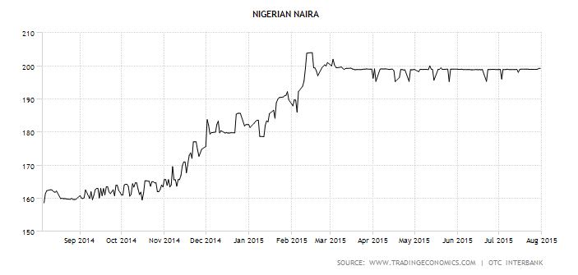
Nigeria Exchange Rates (Naira to Dollar)
Presently, the US dollar was traded at 199.25 NGN on Friday July 31, 2015
-interbank foreign exchange market quotes
The Nigerian Naira reached an all-time high of N204 in February of 2015
and a record low of 0.53 in September of 1980.

Slide 15
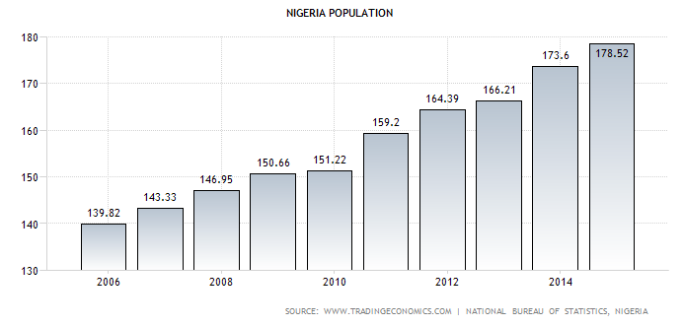
Figure 3: Bar Chart of Trends of Nigeria Population Growth (2006-2015)
Source: NBS report, 2015
The total population in Nigeria was last recorded at 178.5 million people in 2014 from 45.2 million in 1960, changing 295 percent during the last 50 years. Population in Nigeria has been estimated to have reached 178.52 Million in 2014 and recorded as low as 45.15 Million in 1960.
One of the fundamental needs of statistics is to plan efforts toward provision of education, infrastructural facilities and health for all.

Slide 16
Other Demographic indicators
Dependency ratios total dependency ratio: | 89.2 %
Youth dependency ratio: Elderly dependency ratio: | 84 % 5.2 %
Potential support ratio: | 19.3 (2014 est.)
Population growth rate | 2.47% (2014 est.)
Birth rate | 38.03 births/1,000 population (2014 est.)
Death rate | 13.16 deaths/1,000 population (2014 est.)
Total Fertility Rates | 5.25 children/ woman (2014 est.)
Life Expectancy at birth Total Population: Male: Female: | 52.62 years 51.63 years 53.66 years (2014 est.)
CIA World fact book 2014

Slide 17
Major Findings
The major finding of the paper is that Nigeria has little to show for 16 years of democracy so far,
Corruption has demoralize the economy
Naira has been devalued to N204 per US dollar
Unemployment is growing on the high rate.
Nigeria population has increased by 295% in the past 50 years and poverty level is still high, 89.2% are
To explain further, one school of thought says you cannot develop unless you control your population, while the other asserts that you cannot control your population unless you develop.- Malthus Theory of population and Demographic Transition Theory

Slide 18
Conclusions
Thus far this study has shown how the Nigerian 7th republic led by President Muhammadu Buhari (Rtd) can use statistics as a tool to evaluate performance of the previous and his administration.
Whereas on the economic front, the macro economy has grown more rapidly compared to the decade before the period under review, the other economic indicators especially, of unemployment, poverty and employment have been less impressive while the demographic indicators have an alarming result. Thus statistics helps to know how far economic development is keeping pace with the rate of growth in population, which will help the government taking appropriate measures to overcome imbalance between the two

Slide 19
Recommendations
This study recommend:
Refocused mechanism on facts from figure in order to reduce the peril of corruption on the country democracy.
Utilization of statistics as basis for planning and policy making.
Integrated data warehouse be put in place to bring data together at all levels.
Successive 3-5 year periodic survey plan to coordinate nationally representative household and health facility surveys in Nigeria.

Slide 20


Slide 21


