Slide 1
LASSA INFECTION
PRESENTED BY
Dr. OJIRIGHO.E. (M.B.B.S. JUTH)
FEDERAL UNIVERSITY MEDICAL CENTRE OYE-EKITI

Slide 2
OUTLINE
INTRODUCTION
EPIDEMIOLOGY
TRANSMISSION
CASE DEFINITION
CLINICAL PRESENTATION
DIAGNOSIS
TREATMENT
PREVENTION AND CONTROL
CONCLUSION
REFERENCES

Slide 3
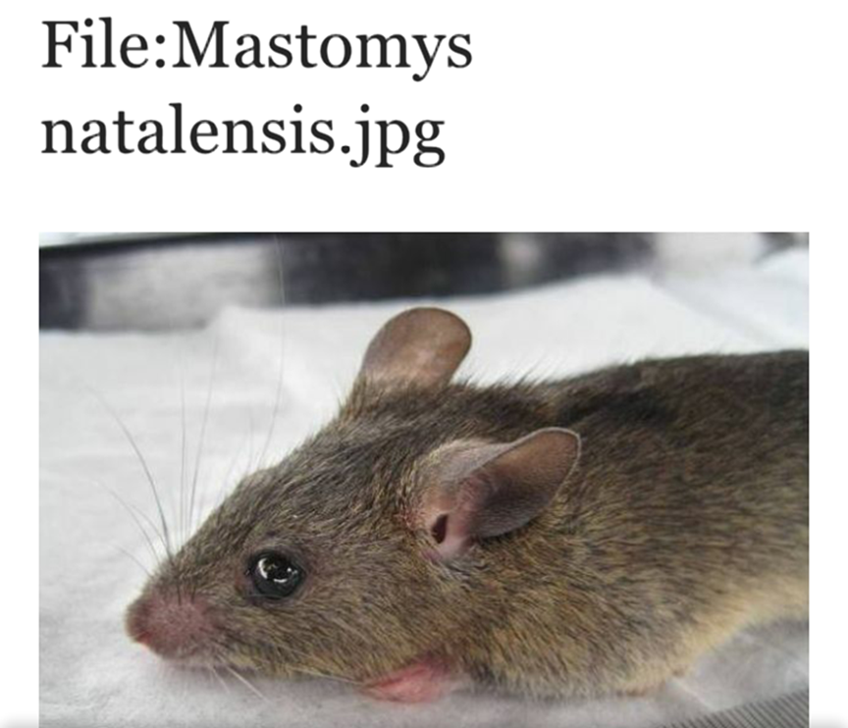
INTRODUCTION
Lassa fever is an infection that belongs to the group of viral Hemorrhagic disease ( ebola, Yellowfever, dengue, marbung,) is a Zoonotic disease (humans become infected from contact with infected animals) caused by the Lassa virus , a single-stranded RNA virus belonging to the arenaviridae family.
The multimammate rat (Mastomys natalensis) is the reservoir host of Lassa virus.

Slide 5
Lassa fever was first described in the 1950’s, however the virus causing the disease was not identified until 1969 when two missionary nurses died in Lassa, a town in Borno State Nigeria.
The last outbreak of Lassa fever in Nigeria occurred in 2012.
Then, the disease affected 19 out of the 36 states, 1,723 suspected cases were recorded and there were 112 deaths.( Painfuly)3 doctors and 4 nurses were reported to be among the fatalities.
This current outbreak began last year November in Bauchi State.

Slide 6
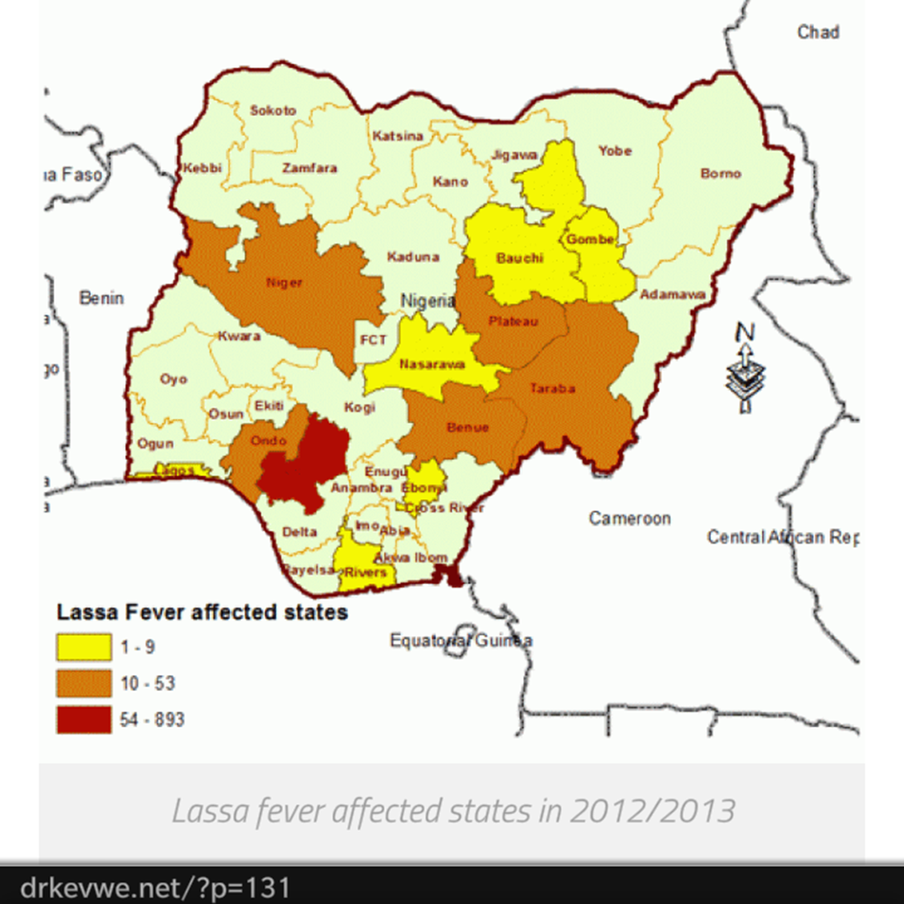

Slide 7
Epidemiology
Lassa fever is endemic in parts of West Africa most especially Sierra Leone, Liberia, Guinea and Nigeria.
It occurs more often in the dry season.
Case fatality rate varies from as low as 1%-25% to as high as 50%.

Slide 9
EPIDEMIOLOGY (ctd)
Cases have been reported in some states in Nigeria in January 2016 which include Bauchi, Kano, Nassarawa, Niger, Rivers, Ondo, Oyo Gombe, Edo, plateau, Taraba ,Lagos, Delta, F,C,T. and ekiti,.
The Health Minister announced that 63 people had died from the current epidemic out of 263 laboratory confirmed cases which has spread to 17 states of the Federation.

Slide 11
TRANSMISSION
The multimammate rat, a rodent found in most homes and eaten as a delicacy in some areas is the host of Lassa Virus.
When these rats become infected with the Lassa Virus they do not become ill, but rather they shed the virus in their urine and faeces.
Humans become infected by direct contact with infected rats and their droppings.

Slide 12
It can also occur through eating food contaminated with the infected rat droppings or the rats itself, exposure to cuts and open wound, touching of contaminated material and via re-usage of needles.
Person to Person transmission occurs via direct contact with body fluids and secretions of infected individuals.

Slide 13
Sexual transmission of Lassa virus has been reported. The virus is excreted in urine for 3-9 weeks and in semen for 3 months.
There is no evidence of airborne person to person transmission.
Health workers and caregivers are at a very high risk of been infected.
Incubation Period is usually range from 6-21 days.

Slide 15
Case Definition:
a) Suspected case- Illnesses with onset of fever, with or without sore throat and at least one of the following signs: bloody diarrhoea, bleeding from gums, bleeding into skin (purpura), bleeding into eyes and urine.
b) Confirmed case- A suspected case with laboratory confirmation (positive IgM antibody or viral isolation) or epidemiological link to confirm cases or outbreaks.

Slide 16
Clinical Presentation
80% of people who come in contact with the virus are asymptomatic The remaining 20% are symptomatic.
1 in 5 infections result in severe disease where major organs are affected.
Symptoms usually begin 6 – 21 days after contact with the virus and death usually occurs within 14 days of onset in fatal cases

Slide 17
. The severity of these symptomatic cases depends on:
host immunity
Mode of infection
Time of presentation

Slide 18
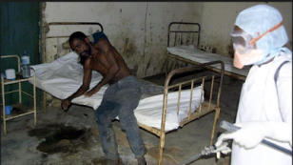

Slide 19
CLINICAL PRESENTATION (ctd)
Mild onset over days: fever, malaise, headache, myalgia, arthralgia, prostration, backache
Gastrointestinal symptoms : anorexia, nausea, vomiting, diarrhoea, abdominal pain
Cough, sore throat, difficulty in breathing, chest pain may be seen
The Central Nervous System may be involved in late stages: agitation, confusion, convulsions and coma
Bleeding
“Classic” presentation: fever, neck/facial swelling, bleeding (petechial haemorrhage) and shock (though not so common)

Slide 20
Pregnant women in the 3rd trimester usually have high death rates; not forgetting high rates of spontaneous abortion.
Because of how unspecific and variable the symptoms of Lassa fever are, it is usually difficult to diagnose clinically.
Patients die from a combination of increased leakages from blood vessels, heart failure, and bleeding disorder leading to shock, NOT just blood loss.
Deafness is a common sequele in up to 1/3 cases.

Slide 22
DIAGNOSIS
Definitive diagnosis requires testing that is available in only specialized laboratories.
Lassa virus infections can only be diagnosed definitively in the laboratory using the following tests:
- Antibody Test: Enzyme-linked immunosorbent assay (ELISA)
- Antigen detection tests
- Reverse transcriptase polymerase chain reaction (RT-PCR) assay
- Virus isolation by cell culture.

Slide 24
These tests can be done at Virology Reference Laboratory at Lagos University Teaching Hospital, Idi-Araba, Lagos. Also at irua specialist hospital Edo state.
Laboratory specimens may be hazardous and must be handled with extreme care.

Slide 26
TREATMENT
SUPPORTIVE
Its put in place to address or relief the symptoms the patient presents with vis-à-vis : replacement of ongoing losses like fluid, blood and its products. Also administration of analgesics, antipyretics, vitamin k.
DEFINITIVE: Antiviral drug

Slide 27
TREATMENT
At present there is no vaccine available that protects against Lassa virus. Ribavirin, an antiviral drug has been found to be very useful in the treatment of Lassa fever patients especially when started within the first six days of the illness. It should be given intravenously for ten (10) days.
1) Intravenous Ribavirin treatment should start as soon as a diagnosis of Lassa Fever is made.
2) Give a single “loading dose” of 33mg/kg body weight.
3) Then give a dose of 16mg/kg body weight every 6 hours for 4 days.
4) Then give 8mg/kg every 8 hours for 6 days.

Slide 28
5) Complete treatment course for individual patients clearly laying out the correct amount to give each dose.
6) Once started, a Ribavirin treatment should not be discontinued until the 10 days course is complete.
7) Supportive treatment should include; Paracetamol, Vitamin K, Heamacel, Ringers lactate, Quinine lactate, injection and antibiotics; start intravenously.
8) If patient is severely anaemic, consider transfusion.

Slide 29
PREVENTION AND CONTROL
The prevention of Lassa fever is the most cost effective and efficient method of controlling and managing the Lassa infection as in the case of other hemorrhagic viral disease both at community and individual level these include:
Avoid erratic bush burning
Proper waste disposal and sanitation
Storage of food items in RODENTS PROOF CONTAINERS

Slide 31
Grains noticed to be infested with Rat droppings should be disposed off and not eaten
Avoid the eating of rats as one cant tell which is infected as the host does not show symptoms.
Refuse should be thrown far from residential areas and properly burnt.
Avoid soaking Garri…
Avoid contact with rat droppings
Ensure proper hand washing and use of hand sanitizers

Slide 32
Use disinfectants to clean surfaces and floors both in office and homes.
Avoid sharing sharps as 80% of infected individuals are asymptomatic
Avoid unprotected sex for those who have refused to be faithful and for partners whose spouse is infected abstain from sex for the next 3 months of completion of treatment as the virus is still shed in semen even after treatment
Ensure proper hygiene and over crowding in homes (used kitchen utensils, bookshelves, cloth littering)

Slide 33
High Index of suspicion for Lassa Fever should be entertained by health workers to improve case detection.
UNIVERSAL PRECAUTION must be practiced in the management of suspected or confirmed cases as listed below:

Slide 34
1. Appropriate personal protective clothing (hand gloves, facemasks, eye goggles and overall) must be worn when attending to cases.
2. Hands must be washed after each contact with patient or contaminated materials. They must first be rinsed in disinfectant and then washed with soap and water.

Slide 35
3. Instruments and Dressings – Each patient must have an individual thermometer labelled with the patient’s name and kept in a receptacle containing disinfectant. The stethoscope and the sleeve of the sphygmomanometer must be decontaminated between each use by cleaning them with disinfectant solution.
4. Bed covering – The use of a plastic sheet is essential to avoid the contamination of mattresses. They must be large enough to cover the entire mattress, be waterproof, and be thoroughly disinfected after the discharge or the death of patients.

Slide 36
Family members should avoid touching body fluids while caring for sick persons.
Placement of traps in and around homes can help reduce rodent population. Bear in mind that rats must not be handled or eaten and keeping of cats should be encouraged

Slide 38
CASE HISTORY
Some time last year there was a family of 5 living in a 2 bedroom apartment in a new housing site late November the bush surrounding their house was set ablaze
Few days later the family began to notice the movements of rats around the house some occasions the mother had noticed her wrapped EKO being eaten by rat of which would then cut of the seemingly bad part and discard giving the rest to her children

Slide 39
Few weeks later her first and last born fell ill of which they both had a fever and the last born who had associated symptom of inability to swallow died. Then the mother took ill some days later of which she was taken to the hospital when she started passing bloody stool and bleeding from the nose.
The doctor then suspected a case of Ebola virus infection and sample was sent for confirmation, result of which came out to be Lassa virus infection and she was treated and discharged after two weeks.

Slide 40
In Nigeria, Healthcare workers seeing a patient suspected to have Lassa fever should immediately contact the Local Government Disease Surveillance and Notification Officers (DSNOs) and/or epidemiologist in the State Ministry of Health or call the Federal Ministry of Health using the following numbers: 08093810105, 08163215251, 08031571667 and 08135050005.

Slide 41
CONCLUSION
The spread of Lassa fever can be curbed if every individual decides to actively practice necessary safety measures to prevent the disease.
Don’t wait till you see a case, LET’S STOP THE SPREAD! ACT NOW!

Slide 42
References
Pulse news Nigeria, 11:00 am,19th January 2016,
The Rats, Lassa Fever and the Ignorant Nigerian Family; What you must know-: by Dr Nyeche Ovundah, January 9, 2016.
WHO Media Centre/ Fact Sheets, updated March 13, 2015.
Ribavirin for Lassa Fever Post Exposure Prophylaxis, CENTERS FOF DISEASE CONTROL AND PREVENTION Volume 16, Number 12 – December 2010
Lassa fever, Wikipedia, the free encyclopedia.

Slide 43
THANKS FOR LISTENING!!!!

Slide 44
QUESTIONS

